Slide 1
NEO4J CYPHER TUTORIAL WITH PYTHON
PATTERENS
Tutorial 30

Slide 2
PATTERN
Patterns and pattern-matching are at the very heart of Cypher, so being effective with Cypher requires a good understanding of patterns.
Using patterns, you describe the shape of the data you’re looking for. For example, in the MATCH clause you describe the shape with a pattern, and Cypher will figure out how to get that data for you.
The pattern describes the data using a form that is very similar to how one typically draws the shape of property graph data on a whiteboard: usually as circles (representing nodes) and arrows between them to represent relationships.

Slide 3
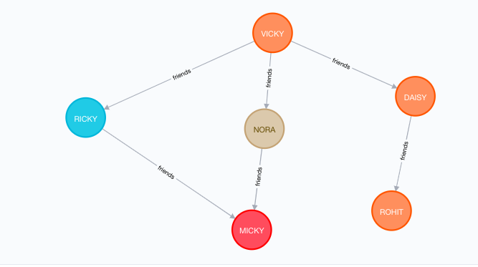
PATTERN

Slide 4
EXAMPLES OF PATTERN WITHOUT RELATIONSHIP
()<--()-->()
()-->()<--()<--()

